Slide 1
STUDENT LEADERSHIP

Slide 2
OF THIS PRESENTATION
To understand how to establish a Student
Leadership Team in order to have Student
Voice in the school.

Slide 3
Definition of Student Voice
“The many ways in which youth might have the opportunity to actively participate in school decisions that will shape their lives and the lives of their peers.
Dana Mitra (2004)

Slide 4
WHAT WE HAVE LEARNED THROUGH RESEARCH
Students are becoming increasingly disengaged from schools and we need to give them a VOICE to increase engagement (Smyth, 2006).
By gathering input from students and involving students we move from things being “done to them” to “working with them”.
If RTI2-B is a school wide process then we need input from all members of the school community. This includes staff, parents and above all else STUDENTS.
Giving students a VOICE in school priorities and reforms is an effective way to improve student outcomes (Mitra, 2006).
Student input is critical in ensuring student engagement.

Slide 5
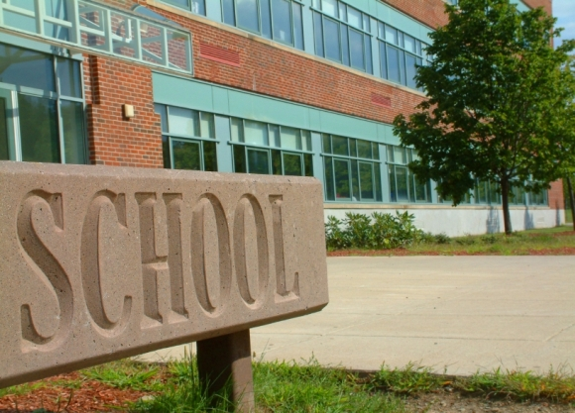
WITHIN SUCCESSFUL SCHOOLS, THERE IS USUALLY A PRESENCE OF CONSISTENT DISCIPLINE.
A CLOSER LOOK AT THESE SCHOOLS INDICATES SUPPORT SYSTEMS WHICH ENGAGE STUDENTS RATHER THAN SIMPLY DEMAND STUDENT COMPLIANCE WITH SCHOOL RULES.

Slide 6
AN EVEN CLOSER LOOK INDICATES GREATER GRADUATION RATES AND INCREASED STUDENT ACHIEVEMENT IN THESE SCHOOLS THAT USE SUPPORT SYSTEMS THAT ENGAGE STUDENTS AND GIVE THEM A VOICE.

Slide 7
Student Voice Is A System That Engages Students
It provides students with a platform to let their thoughts be heard.
It allows for the message to be shared in more student friendly language.
It creates a more positive school culture.

Slide 8
GETTING STARTED
BEING HEARD
COLLABORATION WITH ADULTS
BUILDING CAPACITY FOR LEADERSHIP
Mitra 2006

Slide 9
1. Establish a student leadership team.
The student leadership team is made up of a group
of diverse students. Students are selected from different
grade levels in the building and are academically
and behaviorally diverse.

Slide 10
The School Leadership Team meets with the Student Leadership Team for the purpose of:
Identifying responsibilities and expectations of the Student Leadership Team.
Listening to the Student Leadership Team to gain feedback and suggestions.
Collaborating with the Student Leadership Team to build action plans.
Setting meeting dates in order to build capacity for leadership.

Slide 11
THE STUDENT TEAM MAY
Play a major role in the initial kick-off of RTI2-B.
Work with school administration in planning and preparing student presentations.
Create student surveys to discover what motivates the student body.
Make videos to teach expected behaviors.
Mentor younger students.
Make bulletin boards, welcome and mentor new students, play active role in staff appreciation, write blurbs for newsletters or have a spot on the morning announcements.
Provide suggestion box for student body.

Slide 12
3. Name the student team
Naming the team gives them an identity.
Students will approach the team with ideas and feedback.

Slide 13
ONCE STUDENT VOICE IS IMPLEMENTED
WITH FIDELITY…
It becomes an honor to serve on the team.

Slide 14
EXAMPLE FROM A MIDDLE SCHOOL
Began RTI2-B (PBIS) over 10 years ago.
Faculty wanted to get students more involved in setting the direction and to ensure the use of student friendly language.
Success came with the creation of the Student Respect Team which was named “STARS”.
Succeed
Trust
Achieve
Share
Respect

Slide 15
STARS
FOUR SUBGROUPS
PUBLIC RELATIONS
Students making tickets, bulletin boards, welcoming new students, staff appreciation, writing blurbs for newsletters,planning celebrations, etc.
COMMUNITY
Works with community projects (food drive, clothes drive, making Christmas cards, etc.)
PRODUCTION CREW
Creates videos to reinforce good behaviors
PEER MENTORS
Older students working with younger students

Slide 16
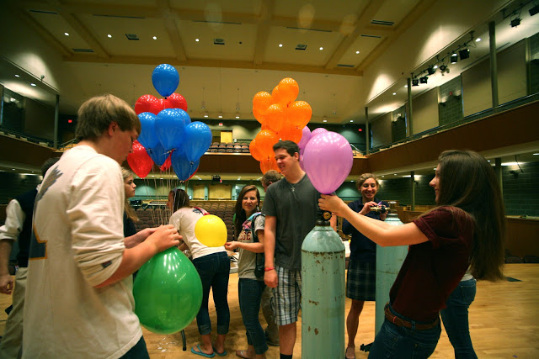
INCREASING STUDENT
VOICE IN SCHOOLS
HELPS CREATE A
SHIFT TOWARDS A
MORE POSITIVE
CLIMATE

Slide 17
YOU MUST LEND AN EAR TODAY IN ORDER TO BUILD LEADERS OF TOMORROW.
https://prezi.com/fzrxzcenmtof/student-voice

Slide 18
REFERENCES
Mitra, D. (2006) Increasing Student Voice and Moving Toward Youth Leadership. The Prevention Researcher.
Smyth, J. (2006) When Students Have Power: Student Engagement, Student Voice, and the Possibilities of Student Reform. International Journal of Leadership in Education.
PBIS at Excelsior Middle School: Student Voice www.tigerpbis.org/2012/11/SLThtml

